Slide 1
Object Oriented Programming Lab #10 Abstract Class, Upcasting & Downcasting in Java
ENGR. SANIYA SARIM

Slide 2
Abstraction
Data abstraction is the process of hiding certain details and showing only essential information to the user.
Abstraction can be achieved with either abstract classes or interfaces
The abstract keyword is a non-access modifier, used for classes and methods:
Abstract class: is a restricted class that cannot be used to create objects (to access it, it must be inherited from another class).
Abstract method: can only be used in an abstract class, and it does not have a body. The body is provided by the subclass (inherited from).

Slide 3
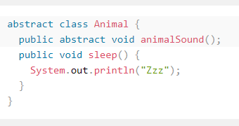

Abstract Class Example
An abstract class can have both abstract and regular methods:
From the example , it is not possible to create an object of the Animal class:

Slide 4
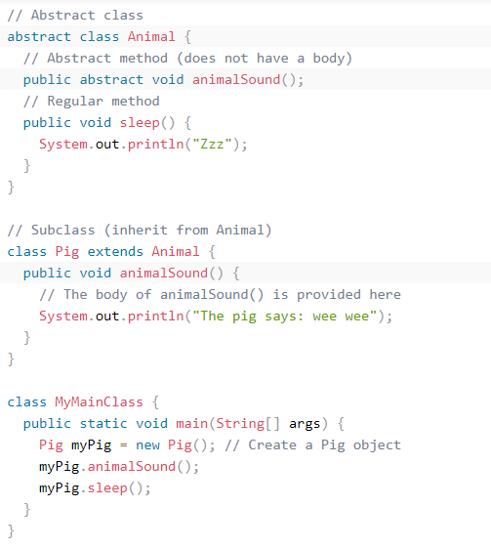
How to access abstract class?
To access the abstract class, it must be inherited from another class.

Slide 5
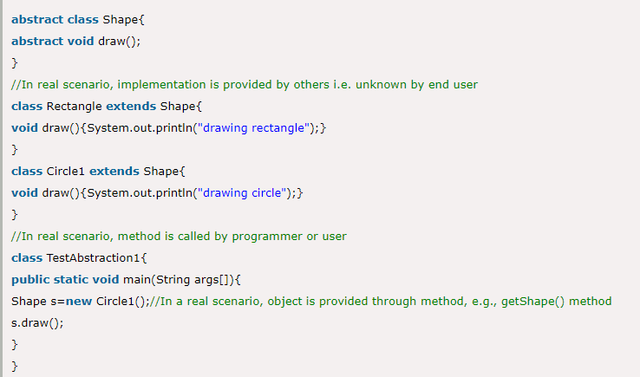
Understanding the real scenario of Abstract class

Slide 6
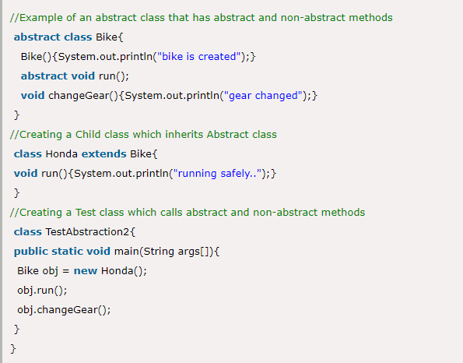
Abstract class having constructor, data member and methods

Slide 7
Why can’t we create the object of an abstract class?
Because these classes are incomplete, they have abstract methods that have no body so if java allows you to create object of this class then if someone calls the abstract method using that object then What would happen?There would be no actual implementation of the method to invoke.
Also because an object is concrete. An abstract class is like a template, so you have to extend it and build on it before you can use it.

Slide 8
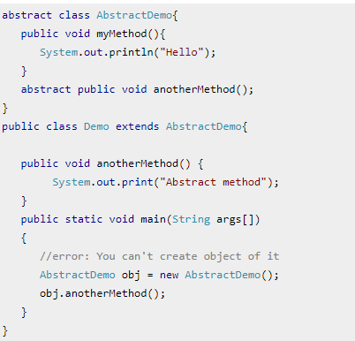
Example to demonstrate that object creation of abstract class is not allowed.

Slide 9
Output
Note: The class that extends the abstract class, have to implement all the abstract methods of it, else you have to declare that class abstract as well.

Slide 10
Key Points:
An abstract class has no use until unless it is extended by some other class.
If you declare an abstract method in a class then you must declare the class abstract as well. you can’t have abstract method in a concrete class. It’s vice versa is not always true: If a class is not having any abstract method then also it can be marked as abstract.
It can have non-abstract method (concrete) as well.

Slide 11
Abstract Method
For now lets just see some basics and example of abstract method.
1) Abstract method has no body.
2) Always end the declaration with a semicolon(;).
3) It must be overridden. An abstract class must be extended and in a same way abstract method must be overridden.
4) A class has to be declared abstract to have abstract methods.
Note: The class which is extending abstract class must override all the abstract methods.

Slide 12
Upcasting Example
public abstract class Animal {
public void eat() {
System.out.println("Eating...");
}
public void move() {
System.out.println("Moving...");
}
public void sleep() {
System.out.println("Sleeping...");}}

Slide 13
Upcasting Example
public class Dog extends Animal {
public void bark() {
System.out.println("Gow gow!");
}
public void eat() {
System.out.println("Dog is eating...");
}
}

Slide 14
Upcasting Example
public class Cat extends Animal {
public void meow() {
System.out.println("Meow Meow!");
}

Slide 15
Upcasting
Upcasting is casting a subtype to a supertype, upward to the inheritance tree. Let’s see an example:
Dog dog = new Dog();
Animal anim = (Animal) dog;
anim.eat();
Here, we cast the Dog type to the Animal type. Because Animal is the supertype of Dog, this casting is called upcasting.
Note that the actual object type does not change because of casting. The Dog object is still a Dog object. Only the reference type gets changed. Hence the above code produces the following output:

Slide 16
Ouput:
Dog is eating…
Note:
Upcasting is always safe, as we treat a type to a more general one. In the above example, an Animal has all behaviors of a Dog.
This is also another example of upcasting:
Animal anim = new Dog();

Slide 17
Why is Upcasting in Java?
Generally, upcasting is not necessary. However, we need upcasting when we want to write general code that deals with only the supertype. Consider the following class:
public class AnimalTrainer {
public void teach(Animal anim) {
anim.move();
anim.eat();
}}
Here, the teach() method can accept any object which is subtype of Animal. So objects of type Dog and Cat will be upcasted to Animal when they are passed into this method:

Slide 18
What is Downcasting in Java?
Downcasting is casting to a subtype, downward to the inheritance tree. Let’s see an example:
Animal anim = new Cat();
Cat cat = (Cat) anim;
Here, we cast the Animal type to the Cat type. As Cat is subclass of Animal, this casting is called downcasting.

Slide 19
When Downcasting fails?
Unlike upcasting, downcasting can fail if the actual object type is not the target object type. For example:
Animal anim = new Cat();
Dog dog = (Dog) anim;
This will throw a ClassCastException because the actual object type is Cat. And a Cat is not a Dog so we cannot cast it to a Dog.

Slide 20
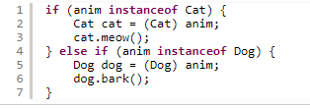
Instance of
The Java language provides the instanceof keyword to check type of an object before casting. For example:

Slide 21
Usage of instanceof Operator
So if you are not sure about the original object type, use the instanceof operator to check the type before casting. This eliminates the risk of a ClassCastException thrown.

Slide 22
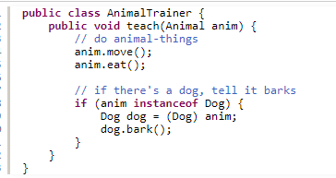
Why is Downcasting in Java?
Downcasting is used more frequently than upcasting. Use downcasting when we want to access specific behaviors of a subtype.
Here, in the teach() method, we check if there is an instance of a Dog object passed in, downcast it to the Dog type and invoke its specific method, bark().

